Slide 1
The Efficacy of a Pre-Workout Vegan Supplement on High-Intensity Cycling Performance in Healthy College-Aged Males
Experiment by Gabrielle Gallien, David Bellar & Greggory R. Davis
Presented by Bailey Morrison
Notes:
-Wanting to focus on effects of an unprocessed vegan pre workout supplement

Slide 2
(2019)
Personal inspiration for looking into a vegan athletics article
Notes:
-Vegan athlete documentary following various athletes and physicians talking about vegan diets involving sports

Slide 3
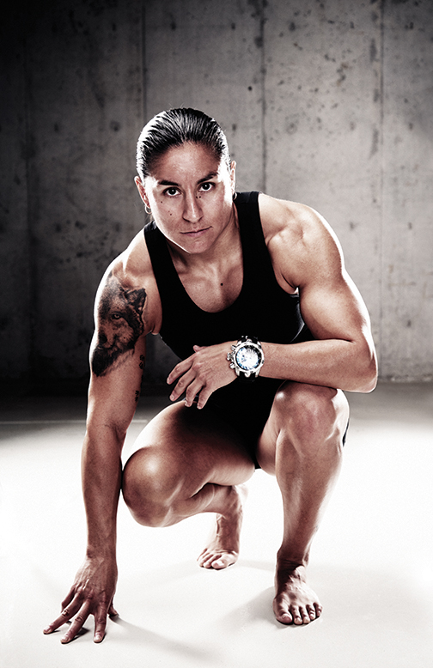
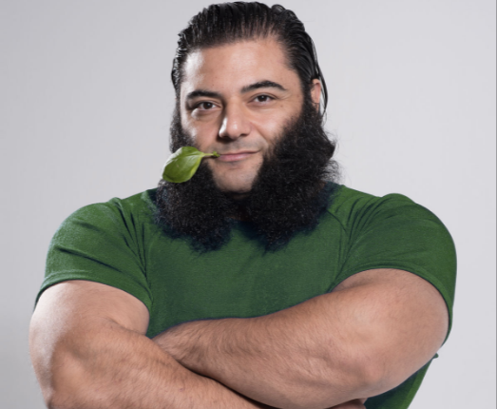
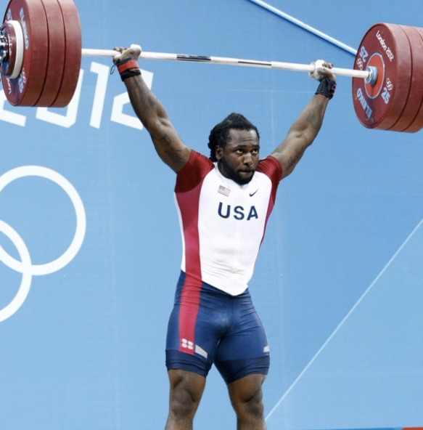
Famous vegan athletes
(2016)
PATRIK BABOUMIAN
MORGAN MITCHELL
VANESSA ESPINOZA
KENDRICK FARRIS
TORRE WASHINGTON
Alpha, Megan, and Kayla Jo Wall. “Vegan Athletes Who Prove You Don't Need Meat to Be Strong.” My Vegan Dreams, 10 Aug. 2016, myvegandreams.com/vegan-athletes/.
Notes:
-A glimpse into the demographics of vegan athletes

Slide 4
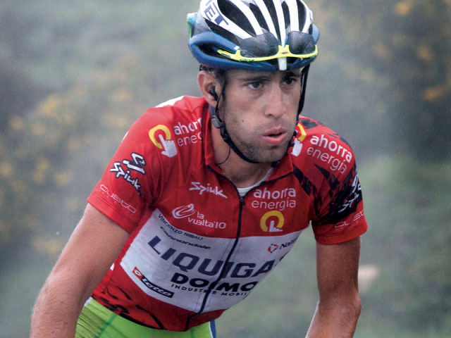
What the Researchers were looking at
Baseline values
Vegan, unprocessed supplement
Isocaloric, processed supplement
Zero-calorie “supplement”
Time to exhaustion
Respiratory exchange rate (RER)
→ VO_{2peak}
Minute ventilation values and respiratory compensation
Notes:
How a unprocessed vegan pre workout supplement compared against a processed supplement with the same number of calories as well as a zero calorie supplement against the baseline values
To do this they had participants cycling on ergometer until they were exhausted measured in seconds, they also recorded the exchange of respiratory gases.
Minute ventilation values and respiratory compensation were used to determine if shifting body temp or pH blood buffering affected results

Slide 5
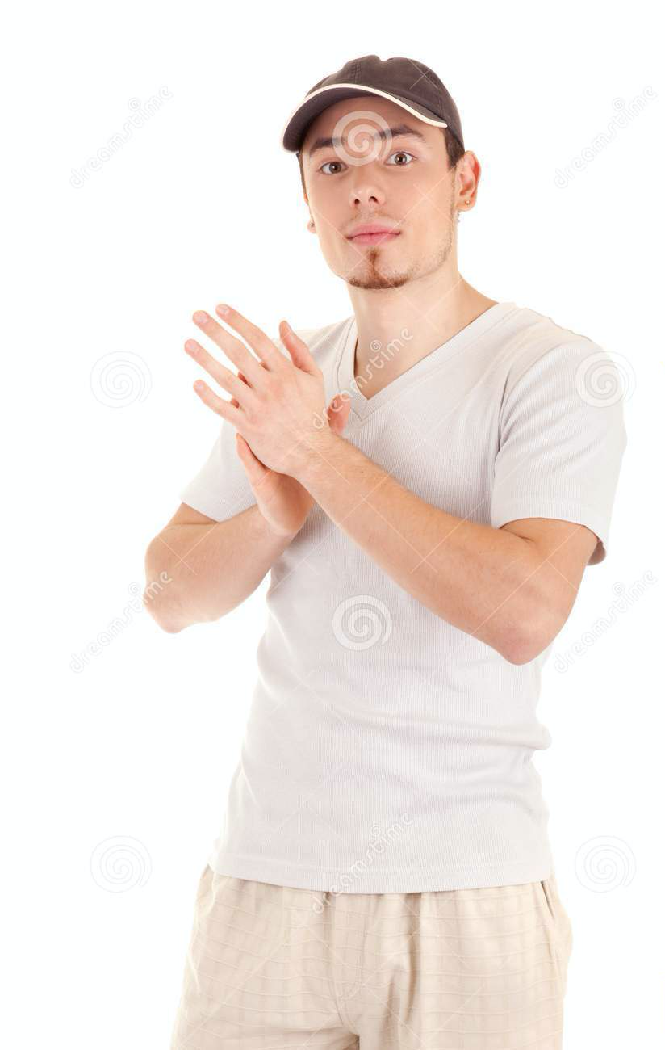
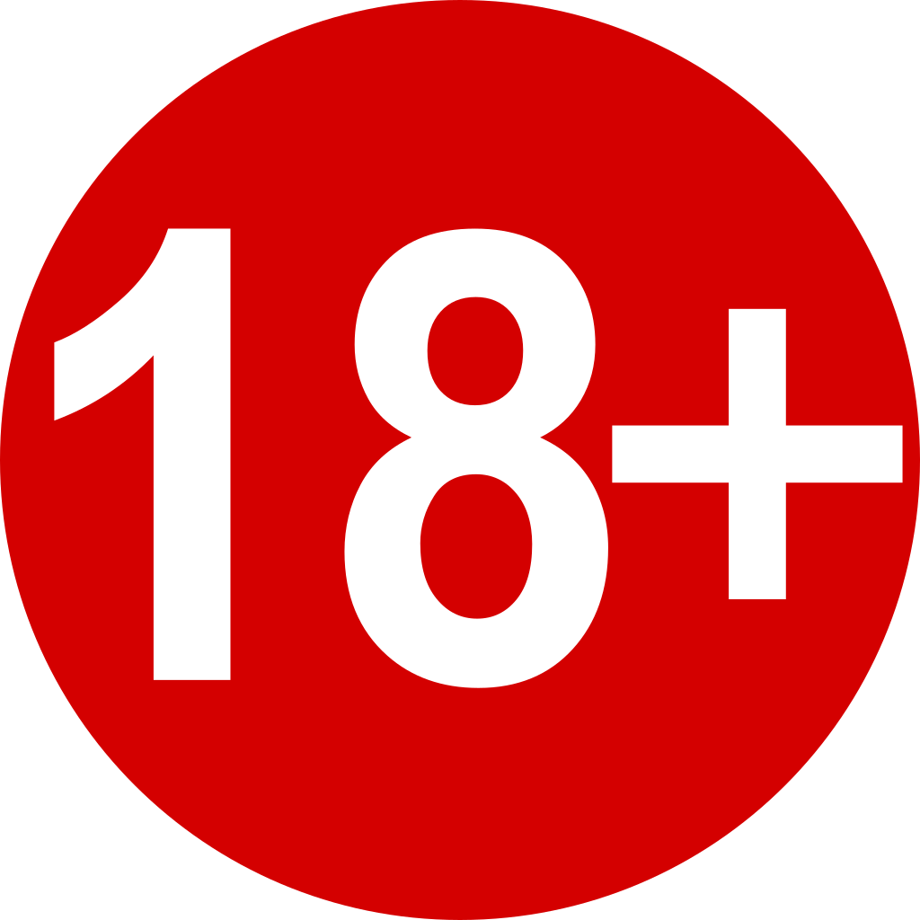
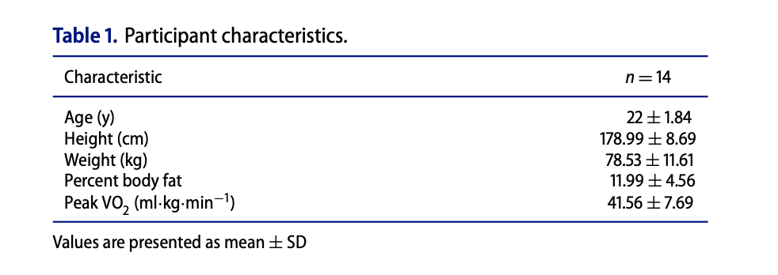
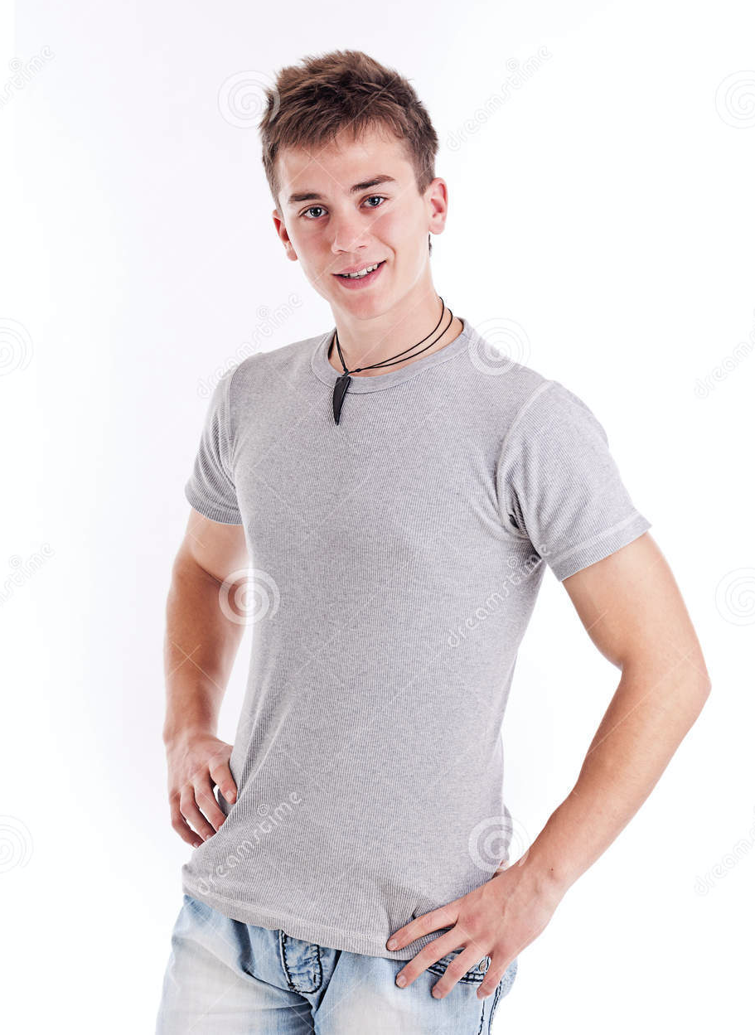
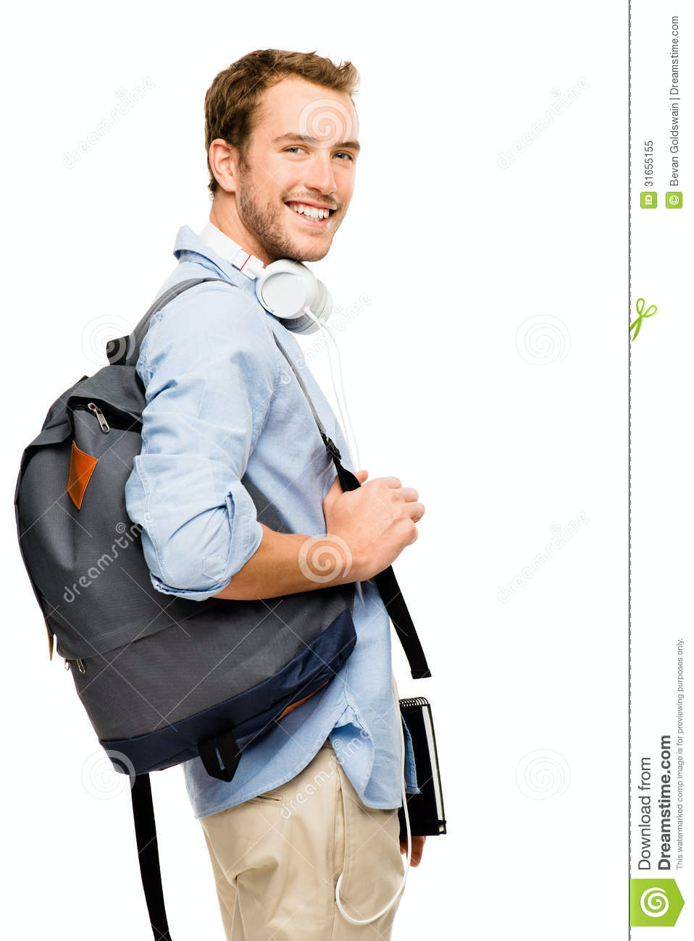
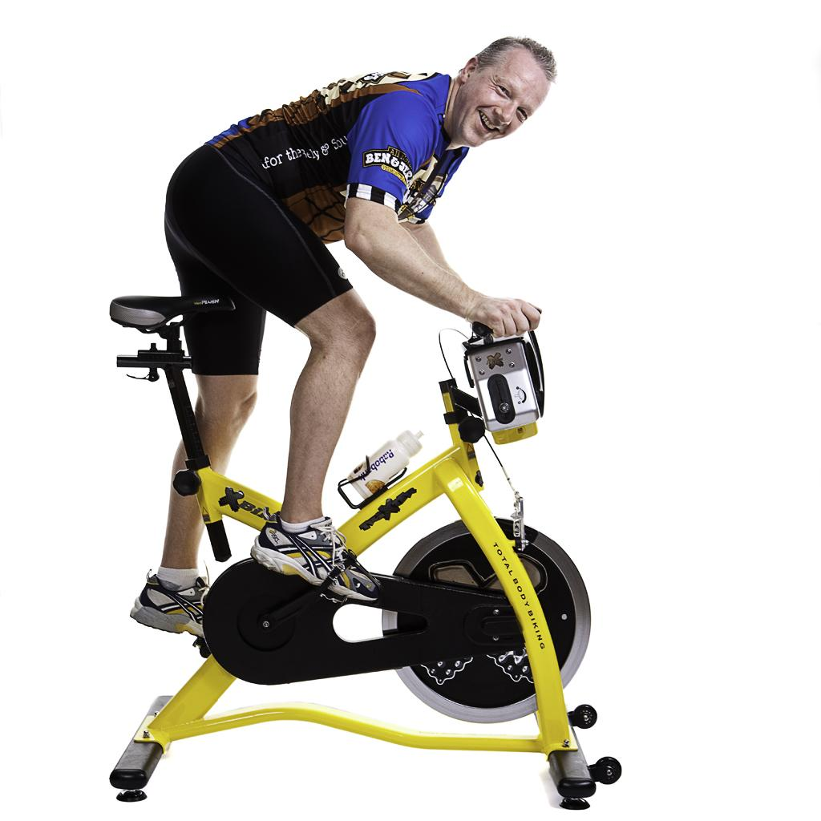
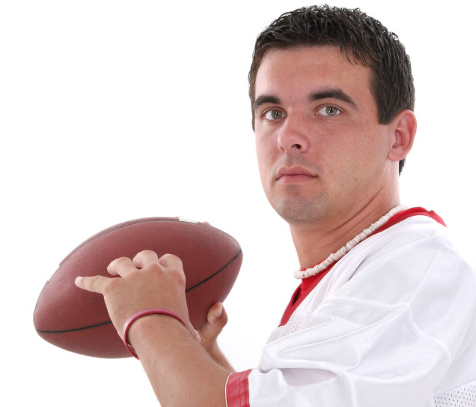
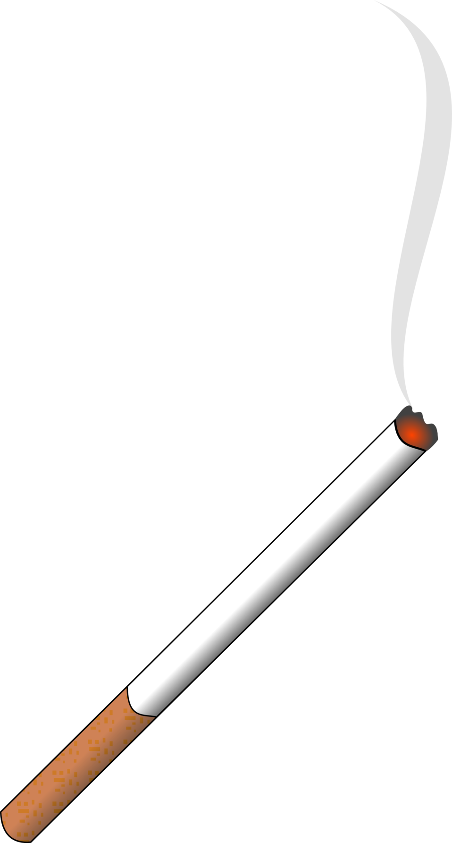
Participants
72 hours prior
14 college-aged, “recreationally active,” white men
BMI 19-30
Notes:
-14 participants, all white men +18 yrs old, nonsmokers, deemed recreationally active
-quite a difference compared to the famous vegan athletes
-meaning they arent on any collegiate or recreational sports teams
-man in bottom left wouldve not been chosen since hes on a sports team, smokes, and is currently on medication
-the participants were barred from cycling exercise up to 6 months prior to study
-72 hrs before each trial they were requested to refrain from caffeine, alcohol, and strenuous exercise

Slide 6
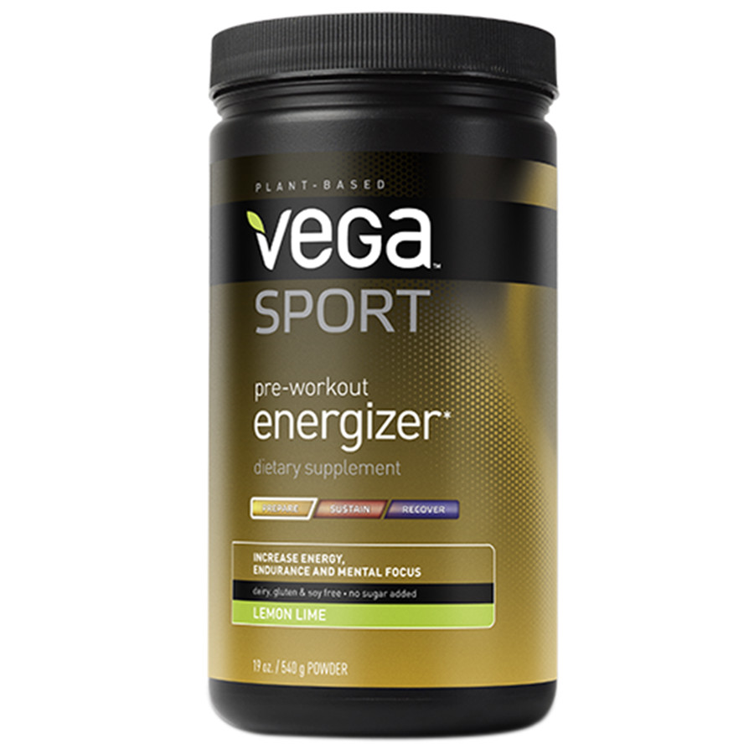
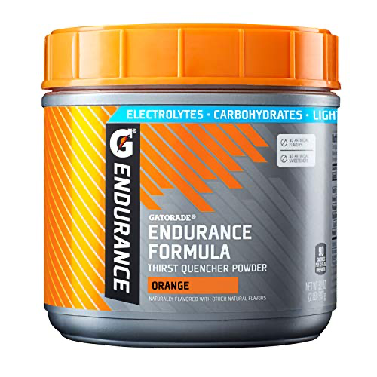
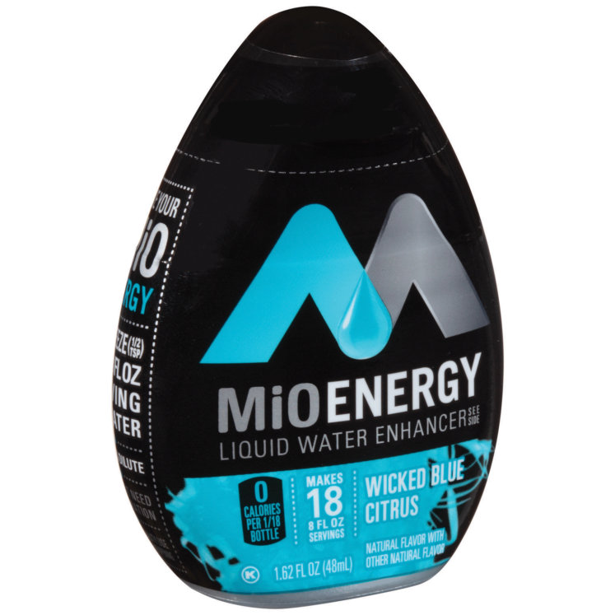
Supplements Used
70 kcal
70 kcal
0 kcal
Notes:
-vega sport
-gatorade isocaloric supplement
-mio liquid water enhancer used to monitor placebo effect and bias from participants and researchers
-randomized by a researched not involved in data collection via randomizer.org
-all formulated to look and taste the same
-a scoop was dissolved in 12 oz of water drank 30 min before trial when participants were sitting down

Slide 7
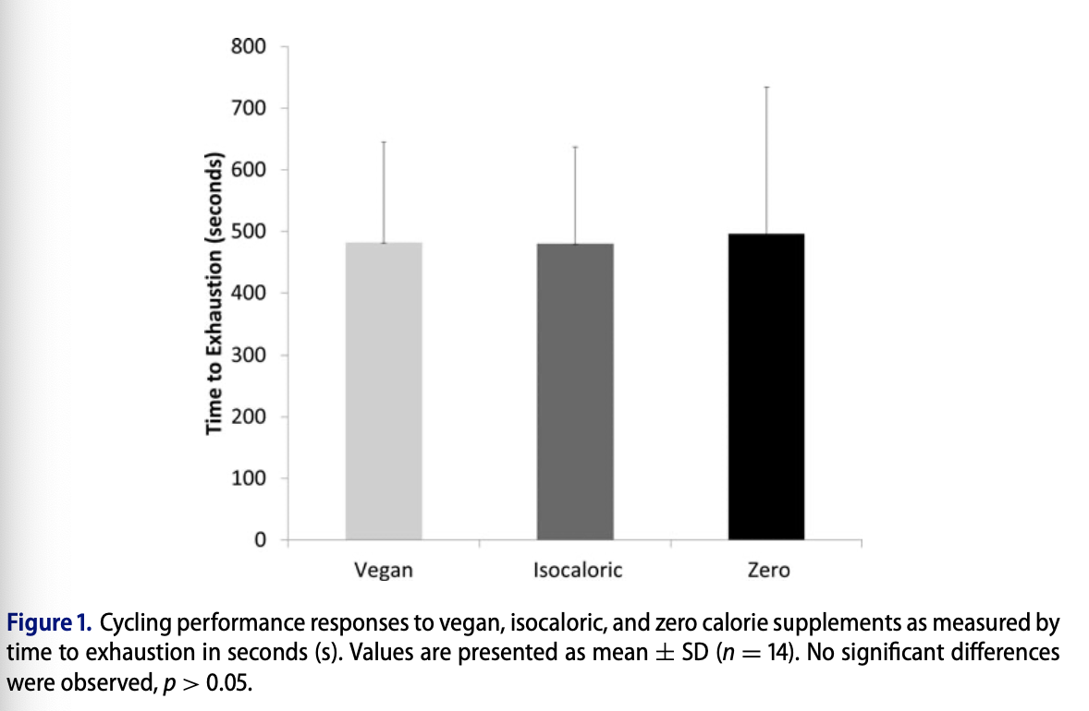
Results
Time until exhaustion yielded no significant differences
RER of zero-calorie induces lower glucose-oxidation and note that supplements can affect substrate metabolism
Source of calories deemed unimportant
482
±
163
480
±
157
496
±
238
Vegan
1.21 ± 0.11
Isocaloric
1.18 ± 0.09
Zero-cal
1.11 ± 0.08
Average RER:
Notes:
-no significant difference between any of the supplements when looking at time to exhaustion
-RER values reflected similar results for the two true supplements when compared to the zero calorie trial set
-this suggests that supplements do affect substrate metabolism
-shifting body temperature nor pH blood buffering were suggested to affect the results due to minute ventilation values and respiratory compensation not being significantly different between the supplements

Slide 8
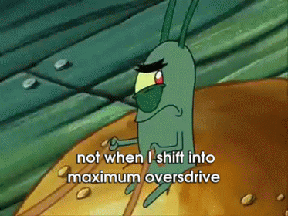
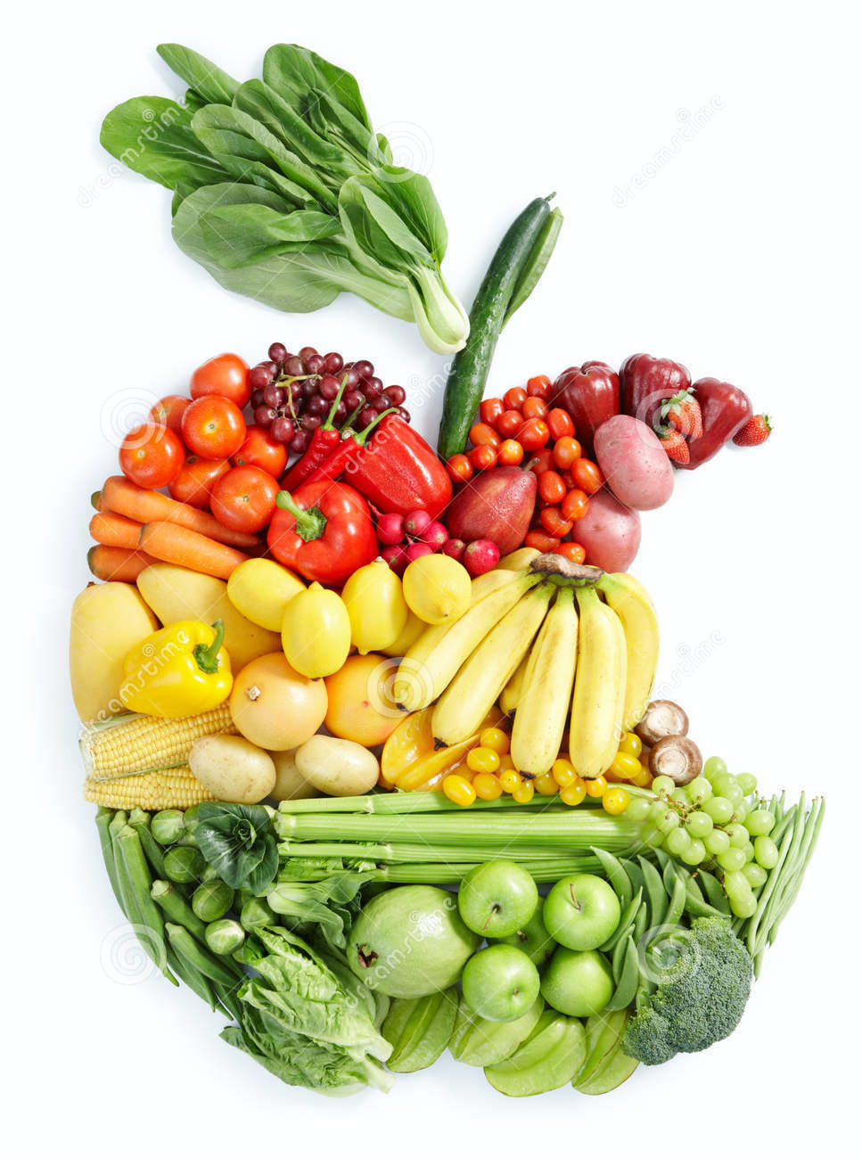
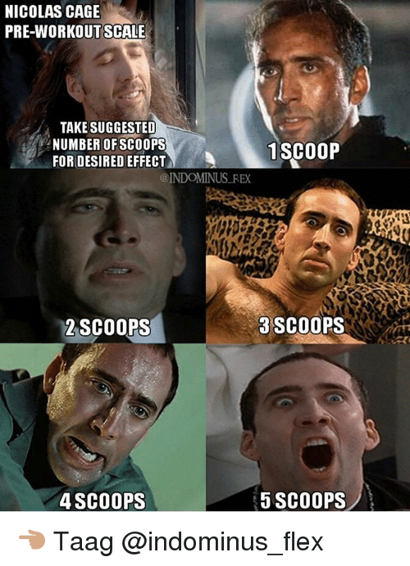
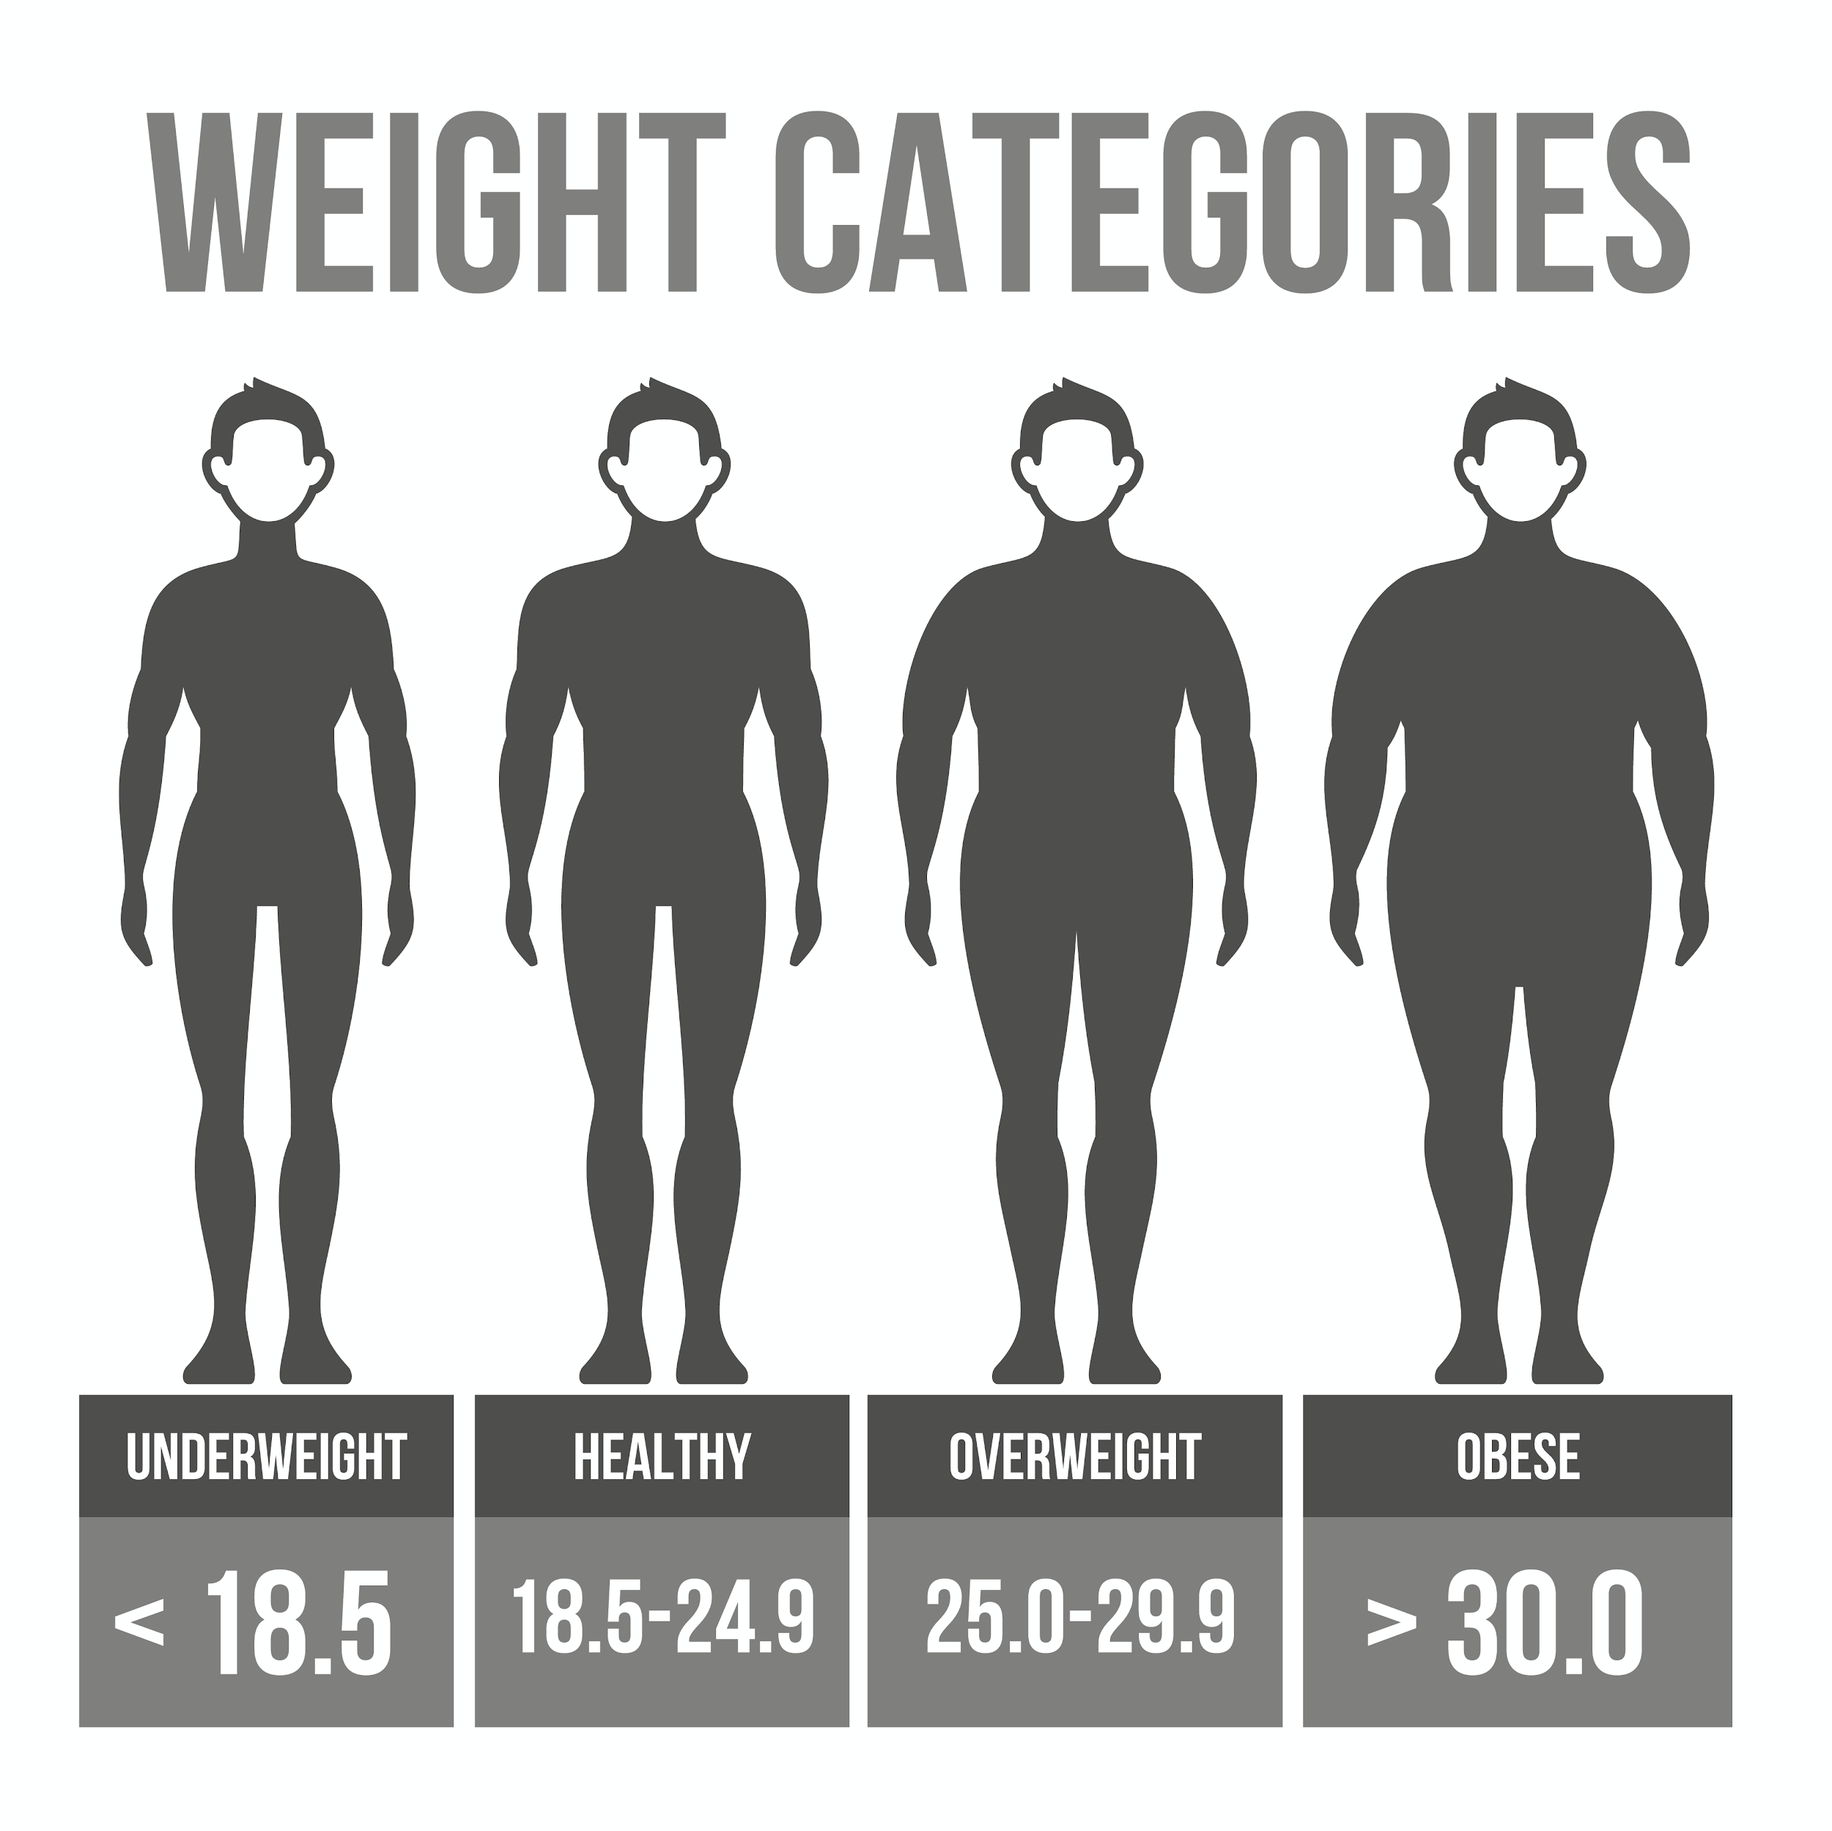
Limitations
Population (n, sex, race, fitness level, dietary history)
Intensity level (80%)
Amount of supplement consumed
When supplement is consumed
VO₂
Notes:
-the population they chose, we only have data from 14 participants that are all white males, females werent chosen for this study due to differing estrogen levels in fear of varying metabolism effects, BMI range of 19-30 was chosen and we know that 30 is the cut off for Obese which we understand can not be an accurate portrayal of health but the researchers suggested that dietary intake nor eating disorders were to be looked into for their participants since they were of “healthy” BMI ranges
-80% intensity level of maximum power was chosen as anything higher results in shorter endurance times like 1-2mins and lower intensity level depend on previous food intake
-small number of kcals is thought to be inadequate for significant performance boost as well as the amount of supplement given. The manufactures’ recommendation of one scoop was used, when I think it would’ve been more interesting to see a higher dosage since it is known in many gym subcommunities to add extra pre workout
-lastly the time of consumption of the supplement can produce varied results, a 1989 study referenced 1989 suggests that intaking carbohydrates while exercising significantly improves exercise performance and this could have been facilitated in this experiment as the unprocessed vegan substitute would be eligible for such effects due to the sugar content (12g)

Slide 9
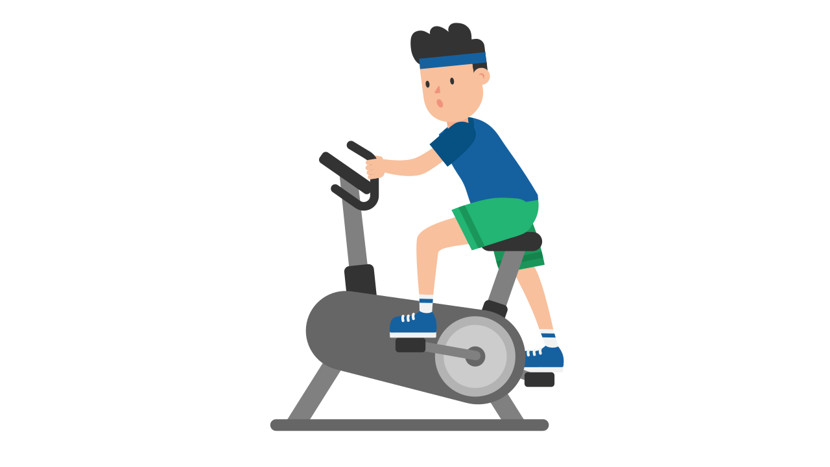
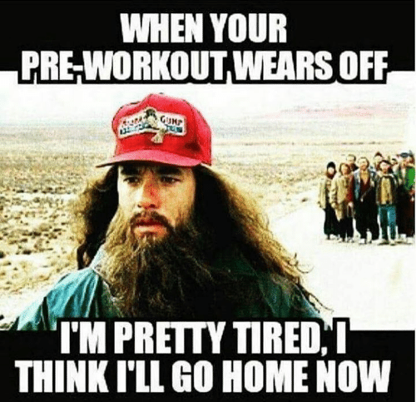
Open for Questions

