Slide 1
Nutrition Screening and Assessment Tool:
Growth Charts
Presented by Bailey Morrison
Clinical Nutrition Masters Student
Dietetic Intern
July 2023

Slide 2
Screening
WHO growth charts
CDC growth charts

Slide 3
Growth in infants and children
Relates to the adequacy of:
Nutrition
Health Status
Economic situation
Environment
Interpreted over time
Some identifiable red flags:
Lack of gaining weight, length, head circumference
Plateau of gaining weight, length, head circumference
Significant drop across percentiles
Dropping without regain in few weeks
Increase of BMI percentile in less than 5 years of age
Increase crossing major percentile lines of BMI

Slide 4
World Health Organization (WHO) Growth Charts
the growth of healthy children aged zero to 59 months in optimal conditions
based on longitudinal data, then cross-sectional data for ages 24 to 59 months.
Breastfed infants only
International sample: prescriptive and growth standard
Davis, California, USA
Muscat, Oman
Oslo, Norway
Ideal for ≤2 years of age
The WHO Child Growth Standards depict normal growth under optimal environmental conditions and can be used to assess children aged birth to 60 months everywhere, regardless of ethnicity, socio-economic status and type of feeding.
Pelotas, Brazil
Accra, Ghana
South Delhi, India

Slide 5
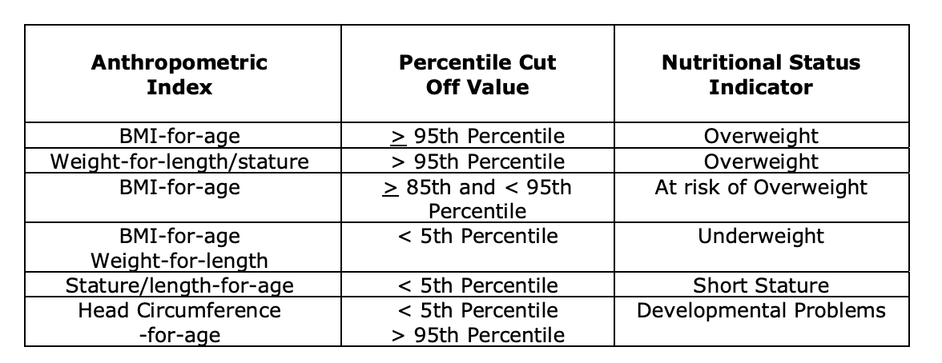
Center of Disease Control (CDC) Growth Charts
Based on cross-sectional data
Breastfed and formula fed infants
USA sample: descriptive and growth reference
Ideal for children >2 years of age
Obese
Overweight

Slide 6
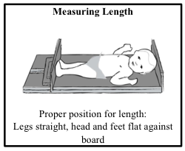
Weight-for-length
Length vs. Height
“Length” <85 cm
~≤2 years of age
WHO growth charts
Recumbent length (laying down)
No clothing or diaper during weight assessment
“Height” or “Stature” ≥85 cm
~>2 years of age
CDC growth charts
Height standing without shoes
Light clothing during weight assessment

Slide 7
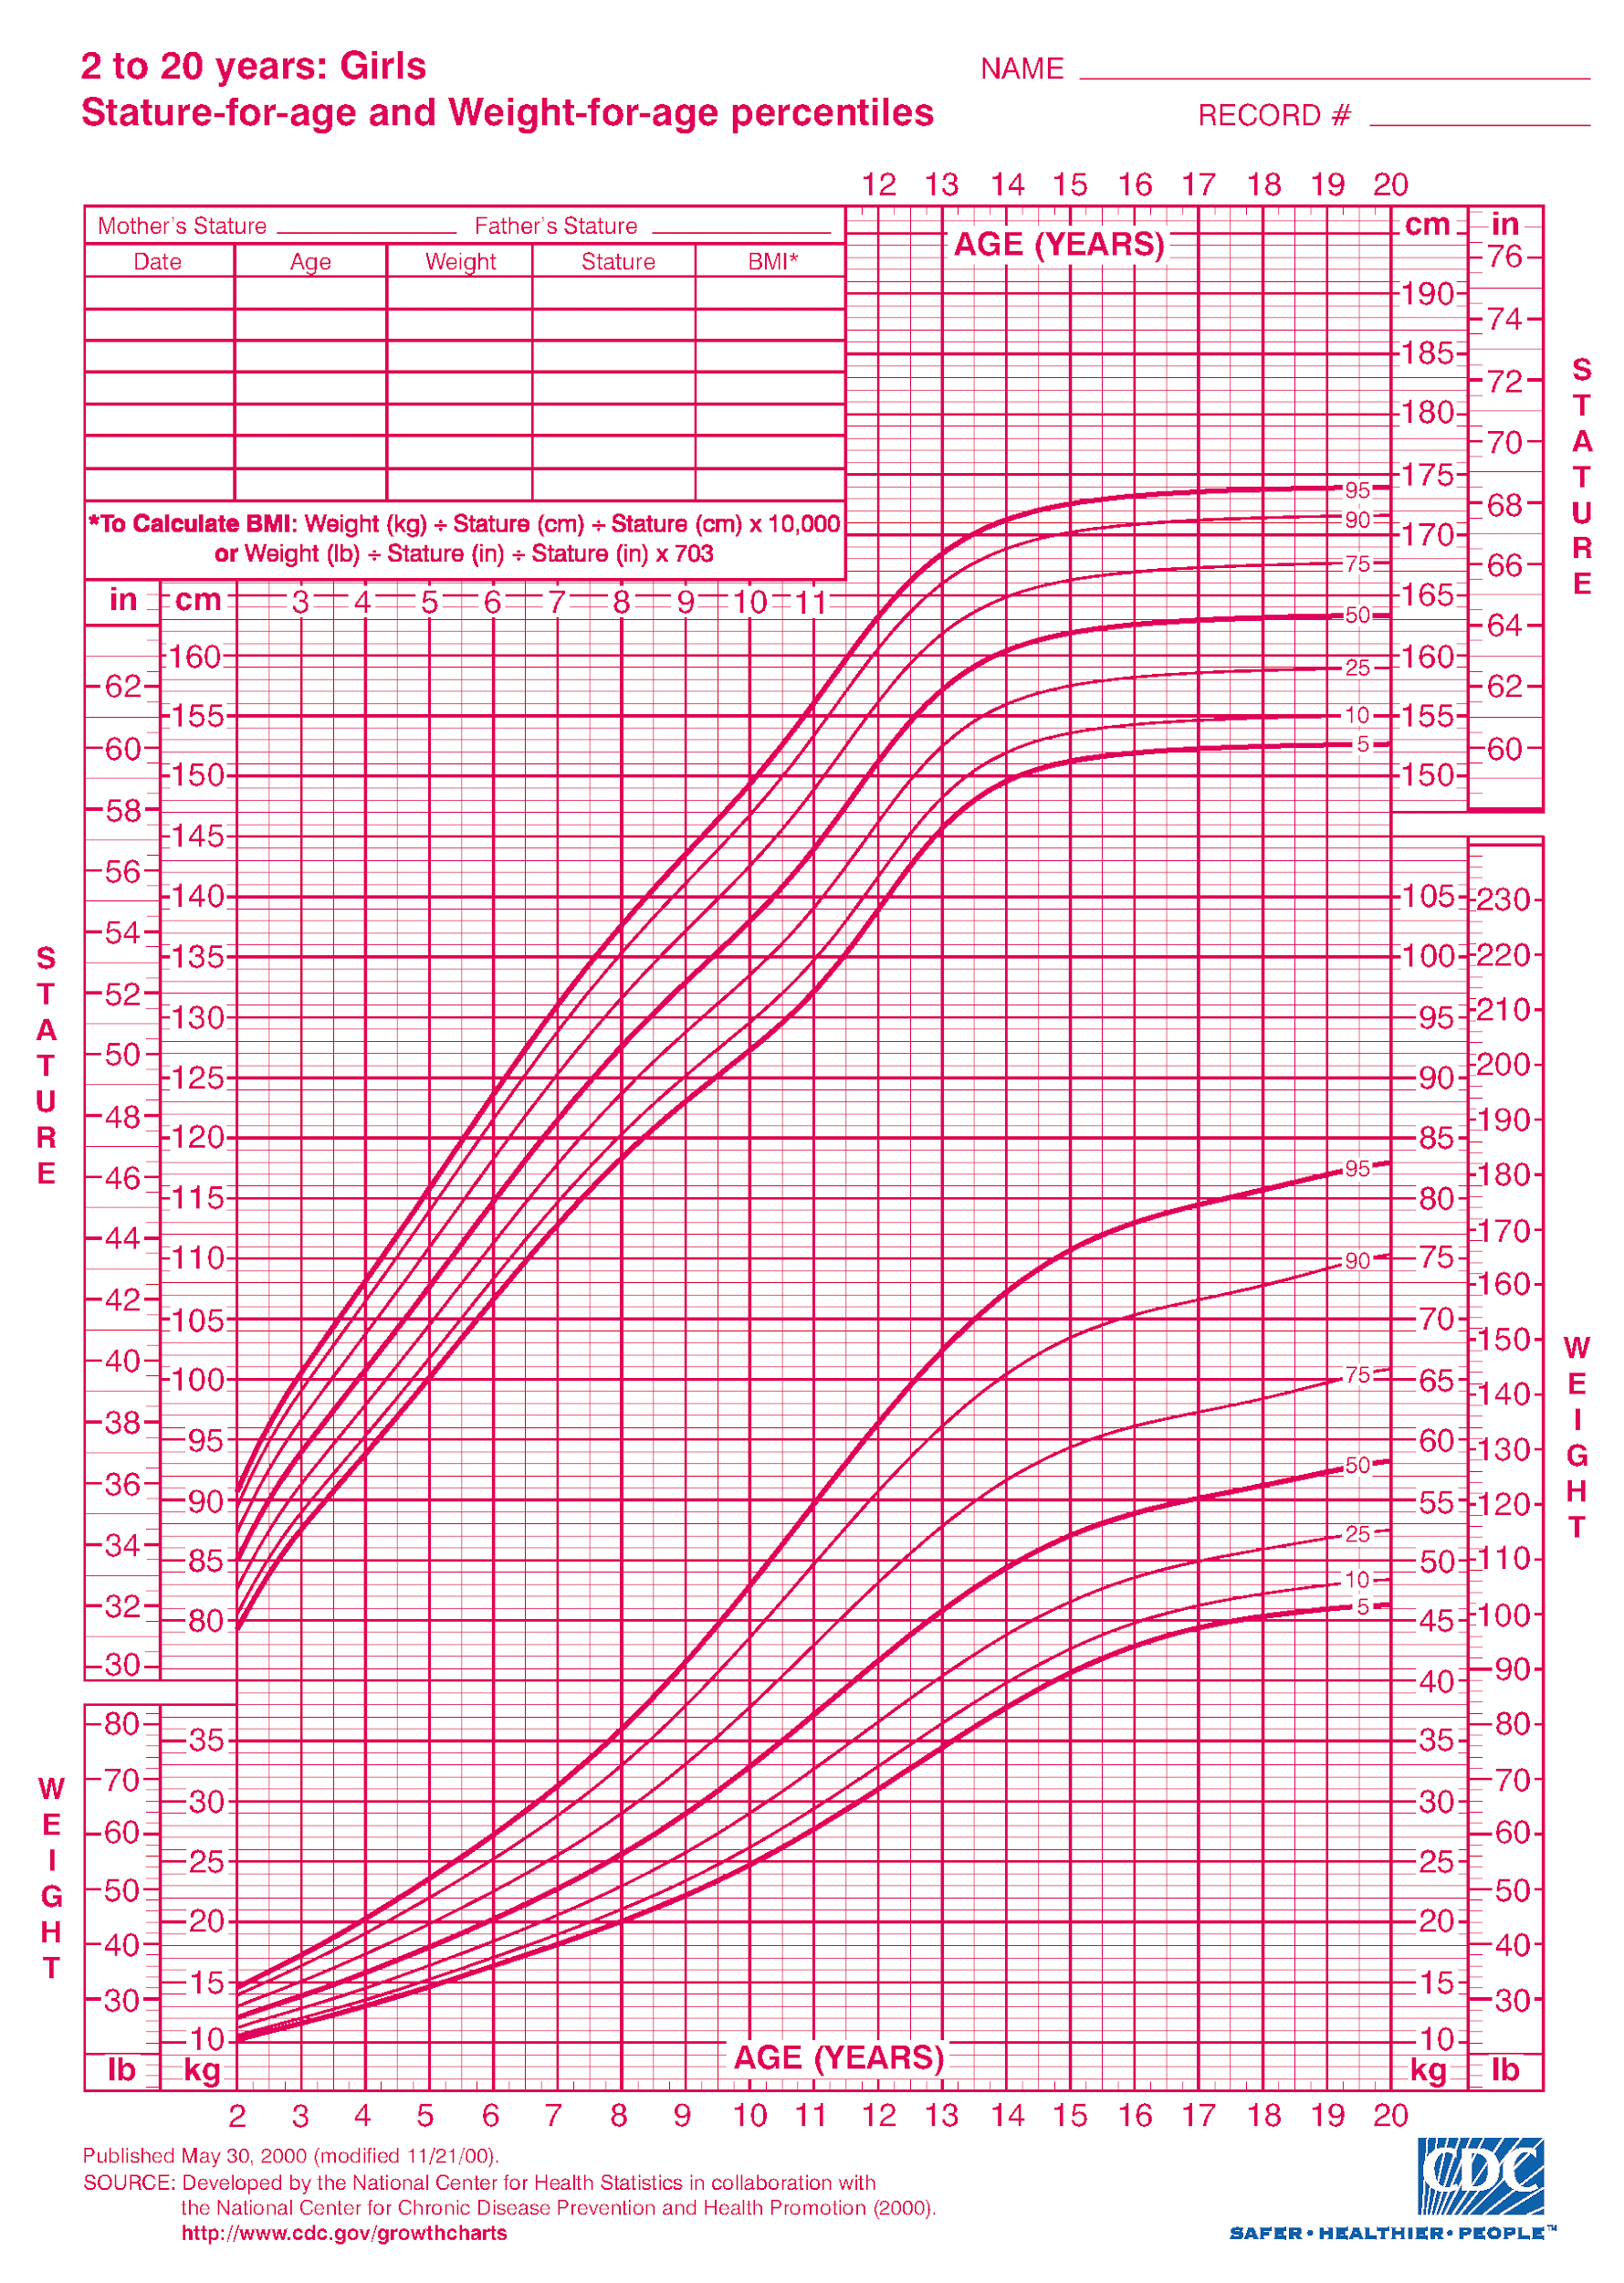
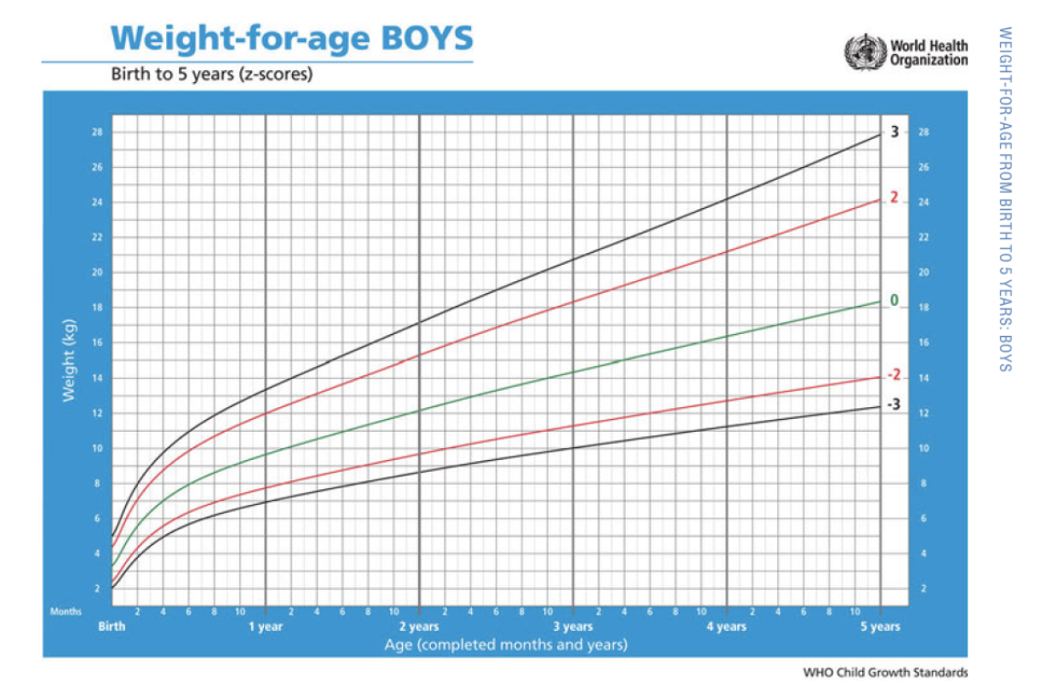
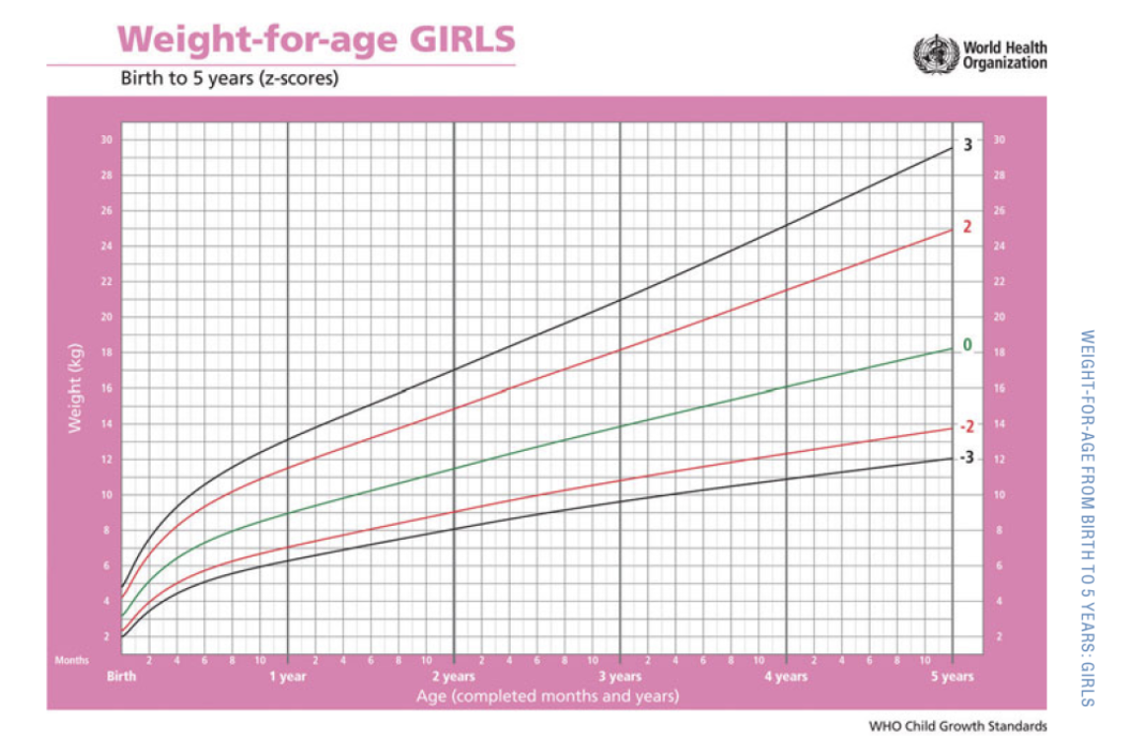
Weight-for-age
WHO charts
CDC example
Ideal ≤2 years of age
No clothing or diaper during weight assessment
>2 years of age
Light clothing

Slide 8
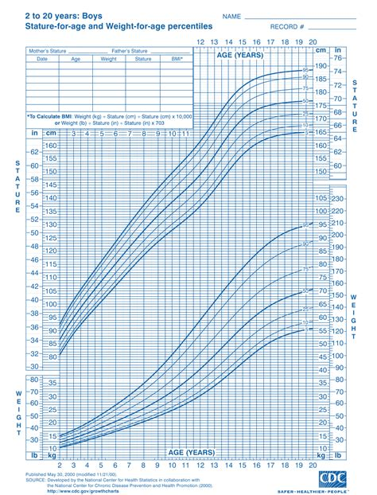
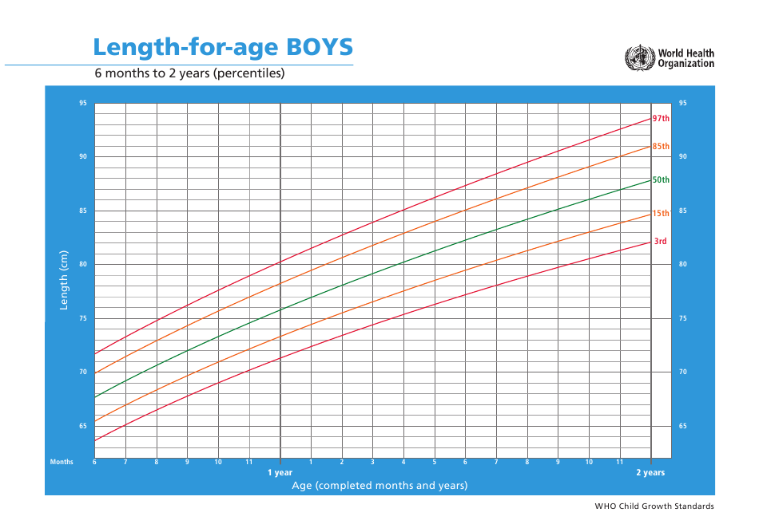
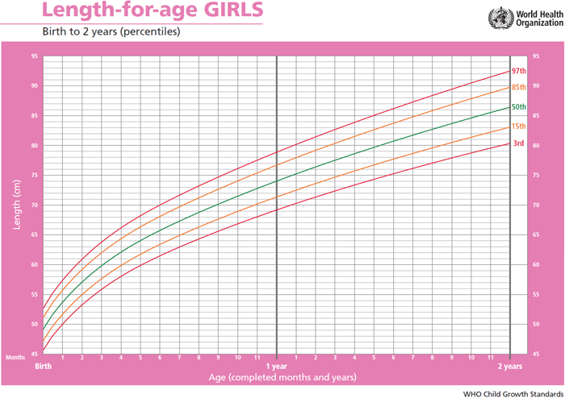
Length-for-age
WHO charts
CDC example
Ideal ≤2 years of age
Recumbent length (laying down)
>2 years of age
Height standing without shoes
“Stature-for-age”

Slide 9
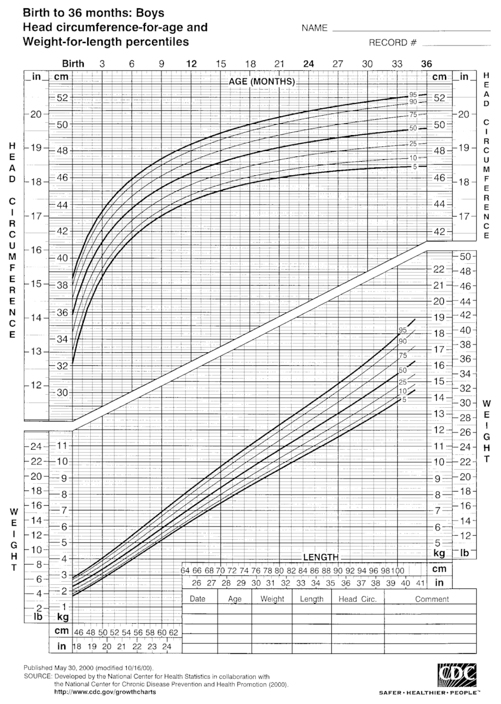
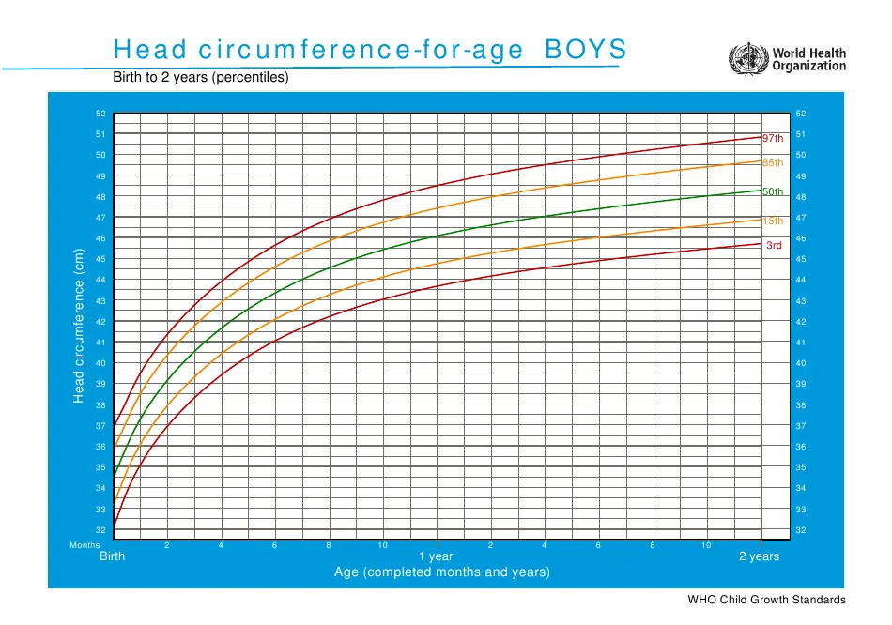
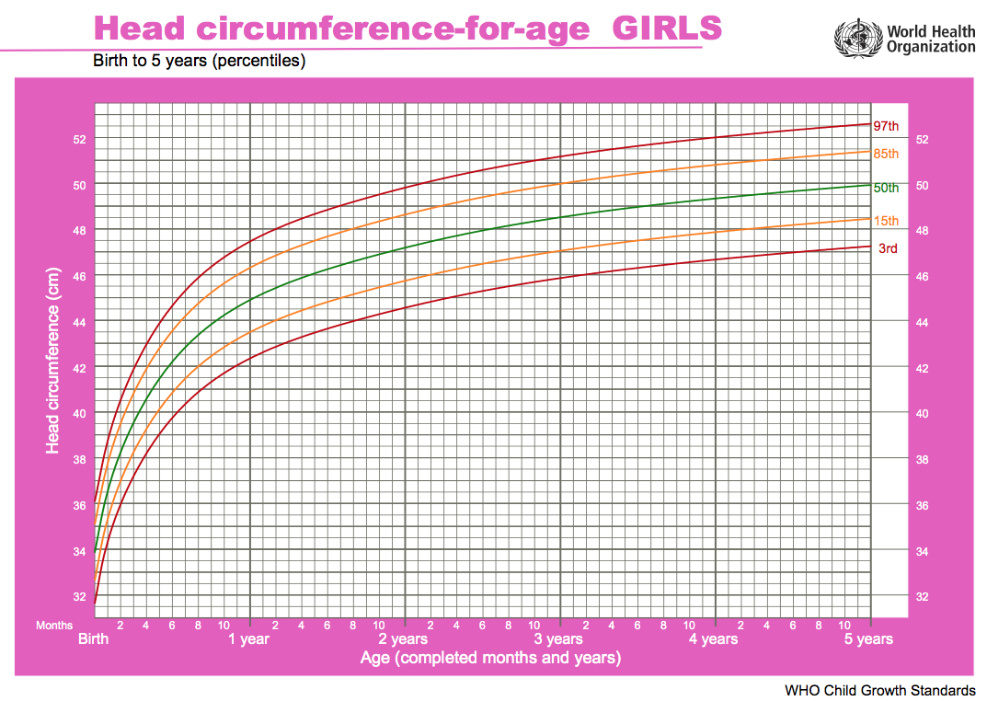
Head circumference-for-age
WHO charts
CDC example
≤2 years of age
>2 years of age

Slide 10
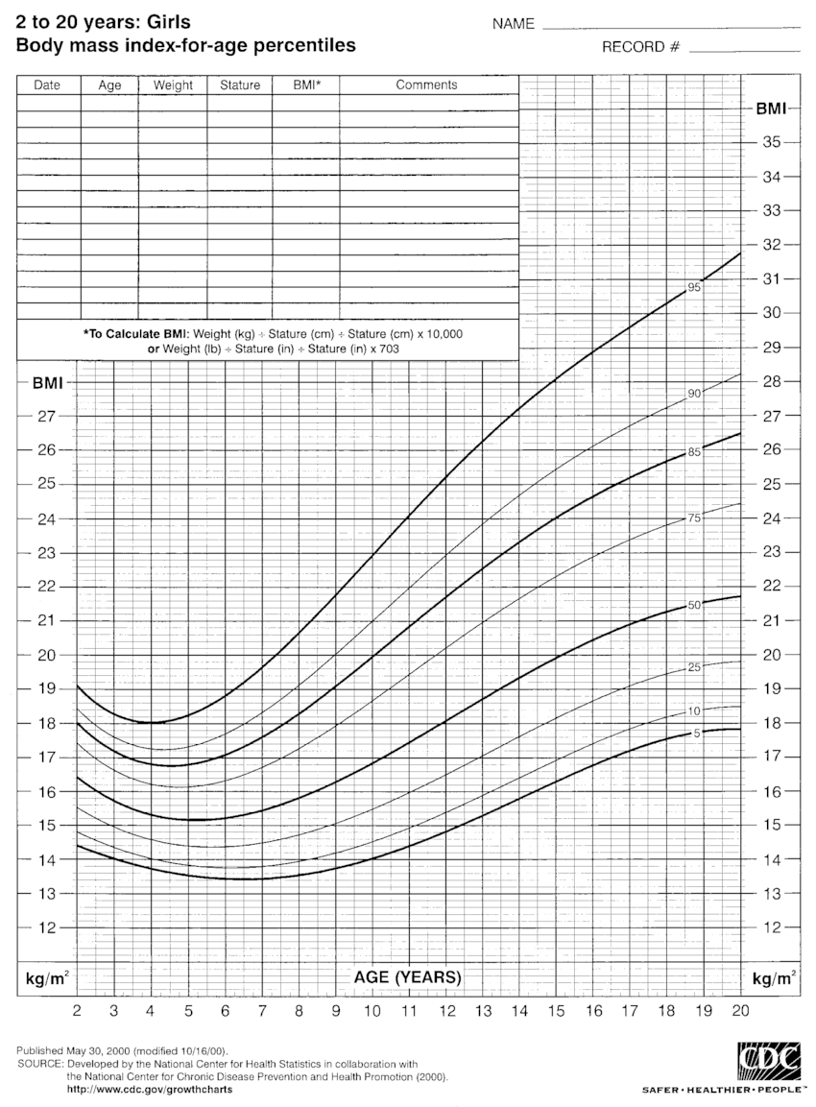
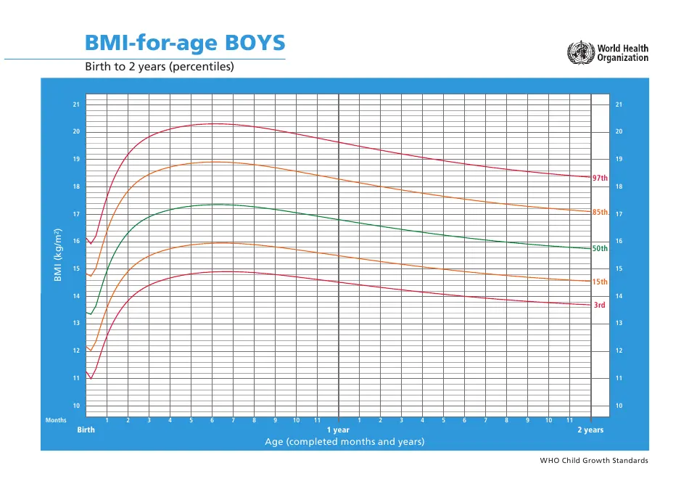
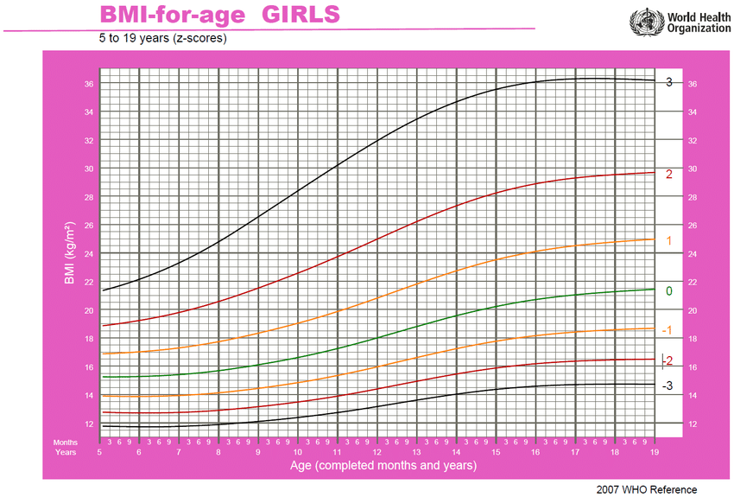
BMI-for-age
WHO charts
CDC example
≤2 years of age
>2 years of age

Slide 11
Case Study
Medical History
Food recall, SGNA questions,
medical diagnoses
Nutrition Care
Physical Exam
PES statement, diagnosis, intervention
SGNA, NFPE
Growth Charts
WHO vs CDC

Slide 12
Case Study
Sarah H. (4 year old female) comes in with her mother because her mother has noticed she’s not gaining much weight from her past Dr’s visit. She is worried about her daughter’s weight, since Sarah is already a petite child. Her mother notes that Sarah does not have much of an appetite because she’s a picky eater. Sarah H. is 31 lbs and 37.5 inches tall. You plot her growth charts and conduct a SGNA.

Slide 13
Case Study
Sarah H. (4 year old female) comes in with her mother because her mother has noticed she’s not gaining much weight from her past Dr’s visit. She is worried about her daughter’s weight, since Sarah is already a petite child. Her mother notes that Sarah does not have much of an appetite because she’s a picky eater. Sarah H. is 31 lbs and 37.5 inches tall. You plot her growth charts and conduct a SGNA.
31 lb / 2.2 = 14.1 kg
13.8 kg IBW
Pt is 97.9% IBW

Slide 14
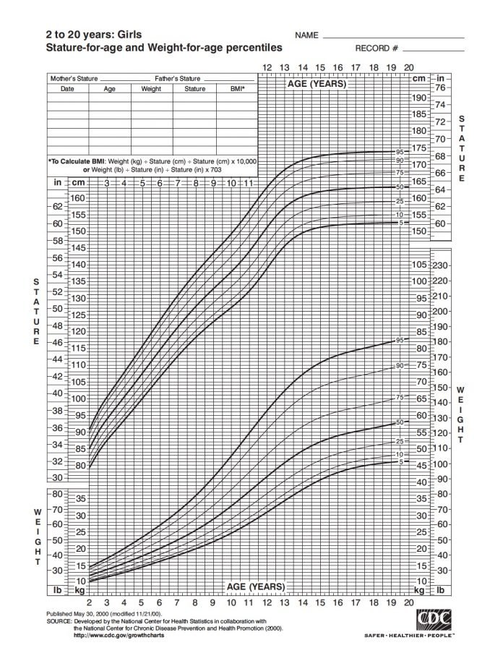
Sarah H.
4 years old
31 lbs
37.5 in
You determine she is in the ___ percentile for stature-for-age
and ___ percentile for weight-for-age
CDC chart for stature-for-age and weight-for-age
in girls 2-20 years old

Slide 15
Sarah H.
4 years old
31 lbs
37.5 in
You determine she is in the 10th percentile for stature-for-age
and 25th percentile for weight-for-age
CDC chart for stature-for-age and weight-for-age
in girls 2-20 years old

Slide 16
Sarah H.
4 years old
31 lbs
37.5 in
You had determined that she is currently in the 10th percentile for stature-for-age
and 25th percentile for weight-for-age
How does that compare to her previous data points? Is there cause for concern? Why?
CDC chart for stature-for-age and weight-for-age
in girls 2-20 years old

Slide 17
Sarah H.
4 years old
31 lbs
37.5 in
She is staying consistent in the 10th percentile range in stature-for-age
But she is on a downward trend for weight-for-age.
She started in the 50th percentile but dropped to the 25th in the last 6 months to 1 year
CDC chart for stature-for-age and weight-for-age
in girls 2-20 years old

Slide 18
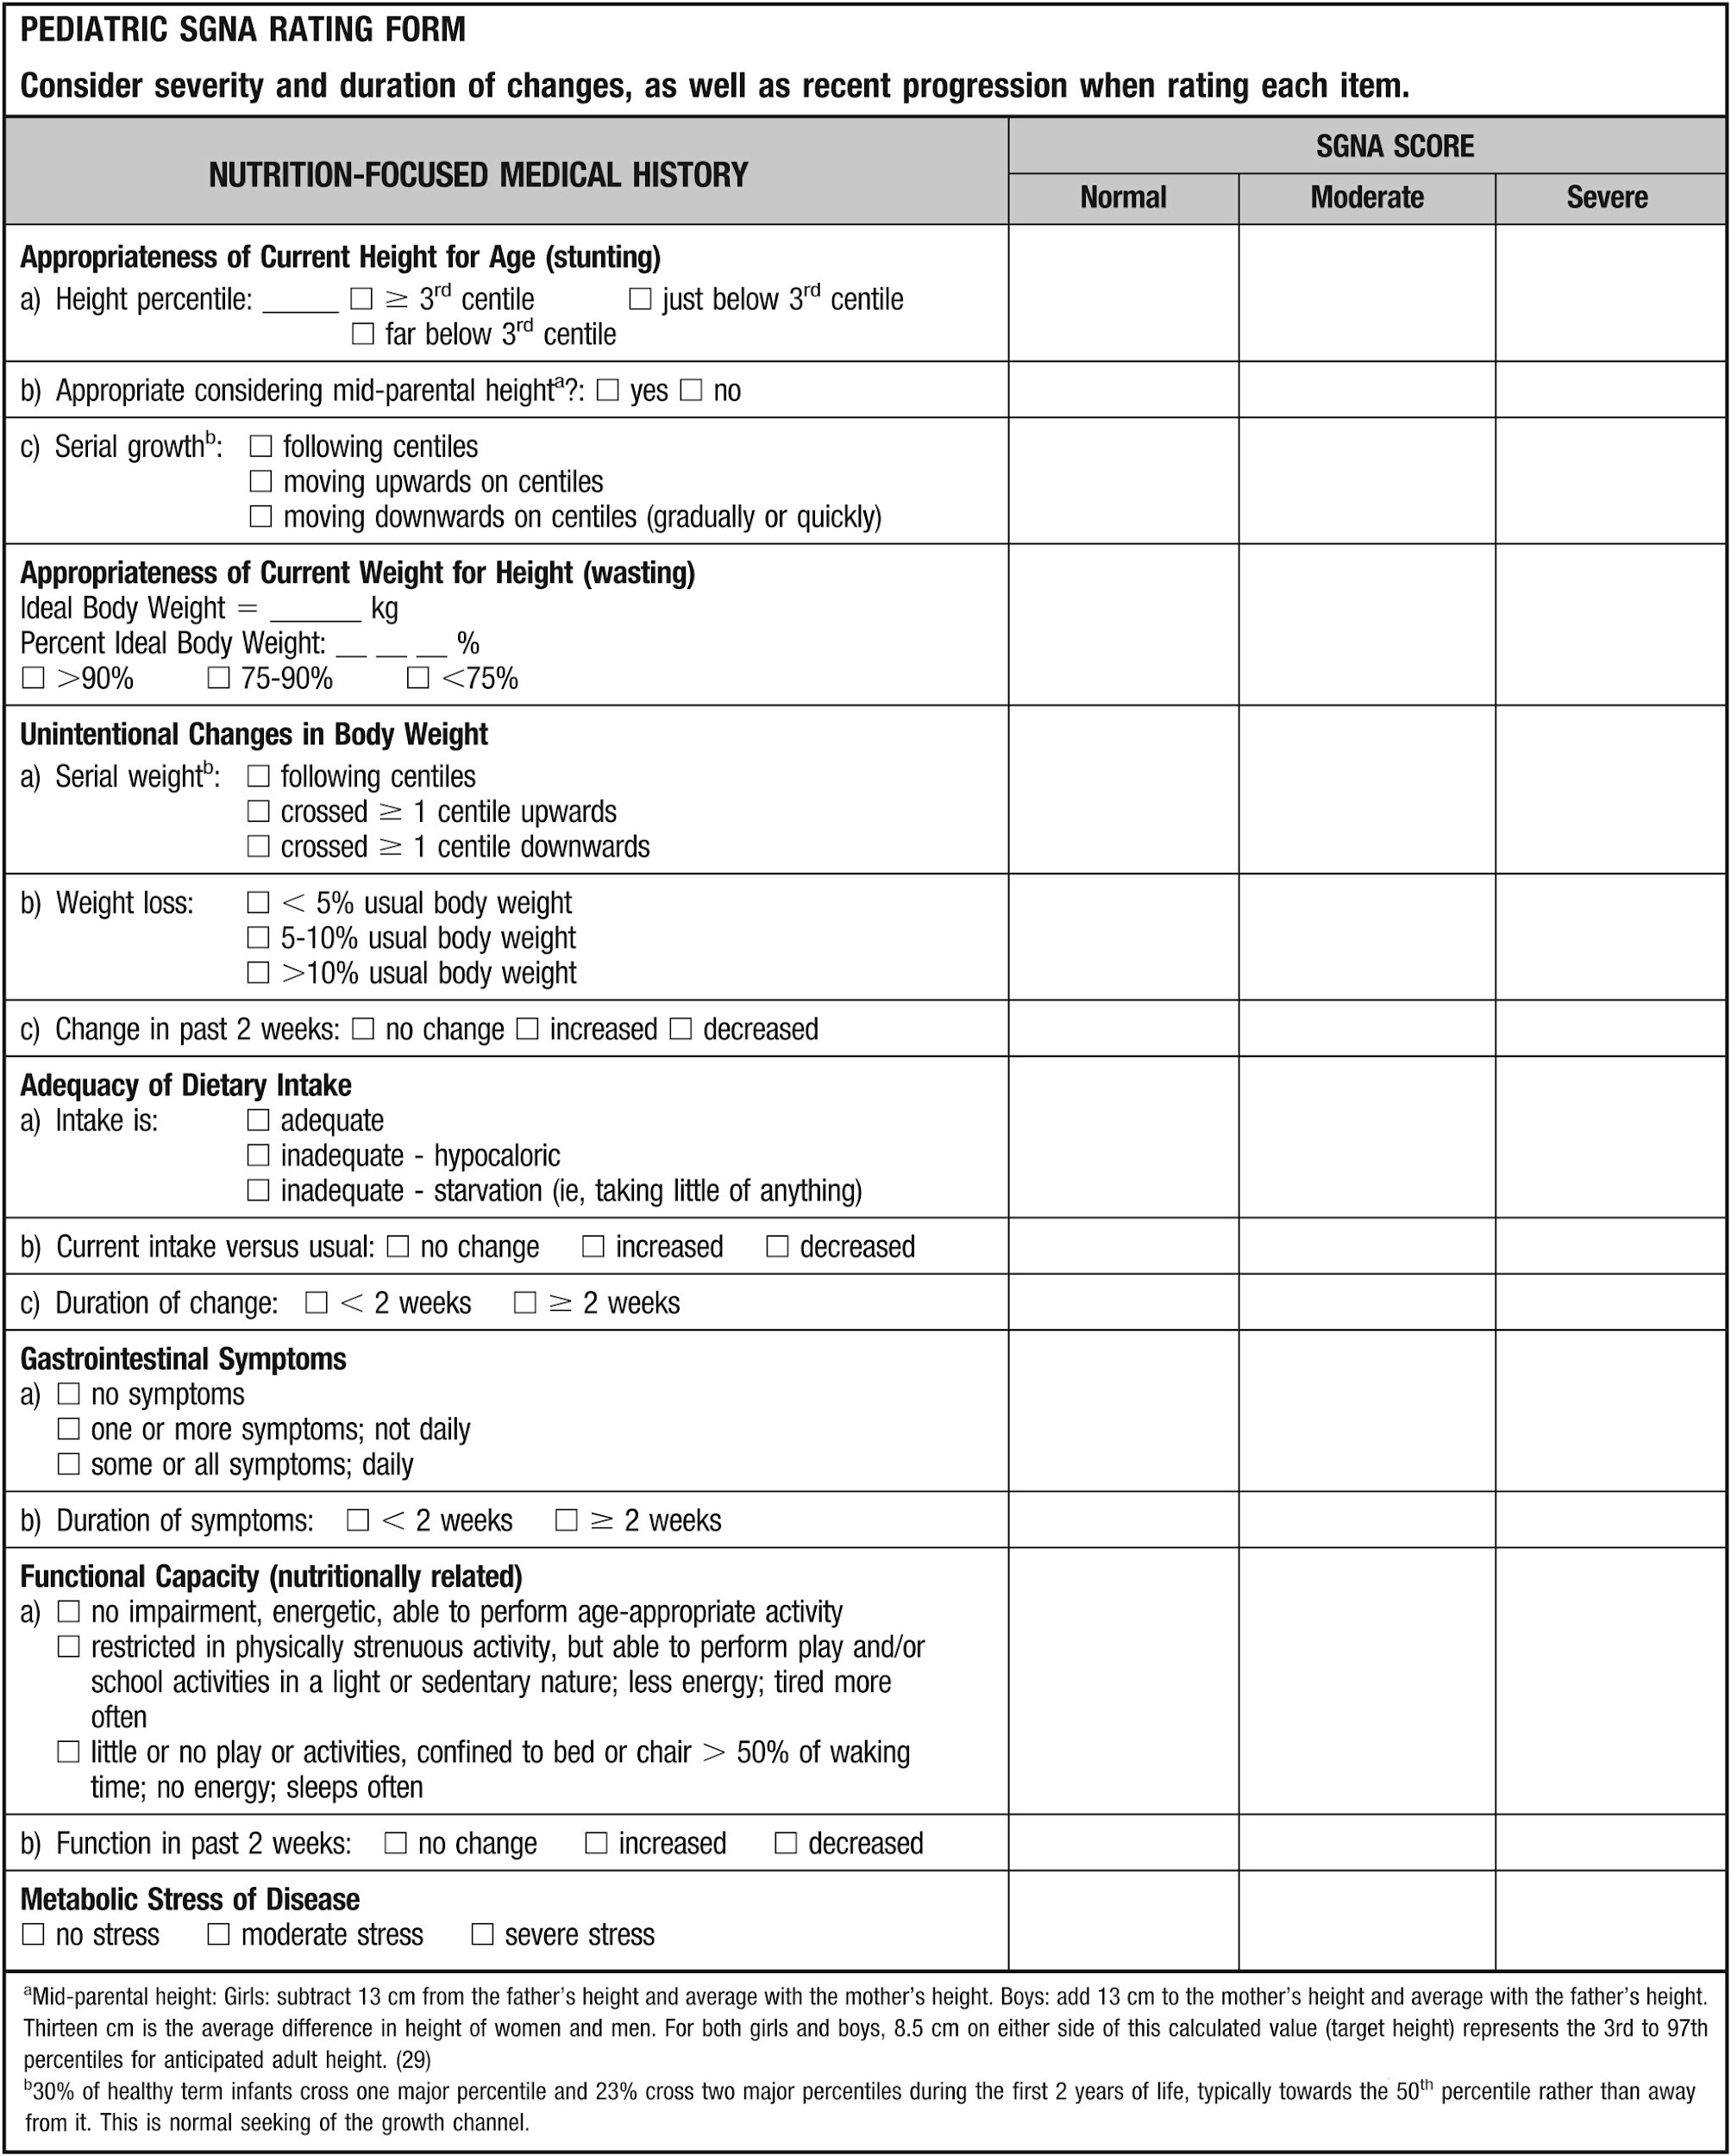
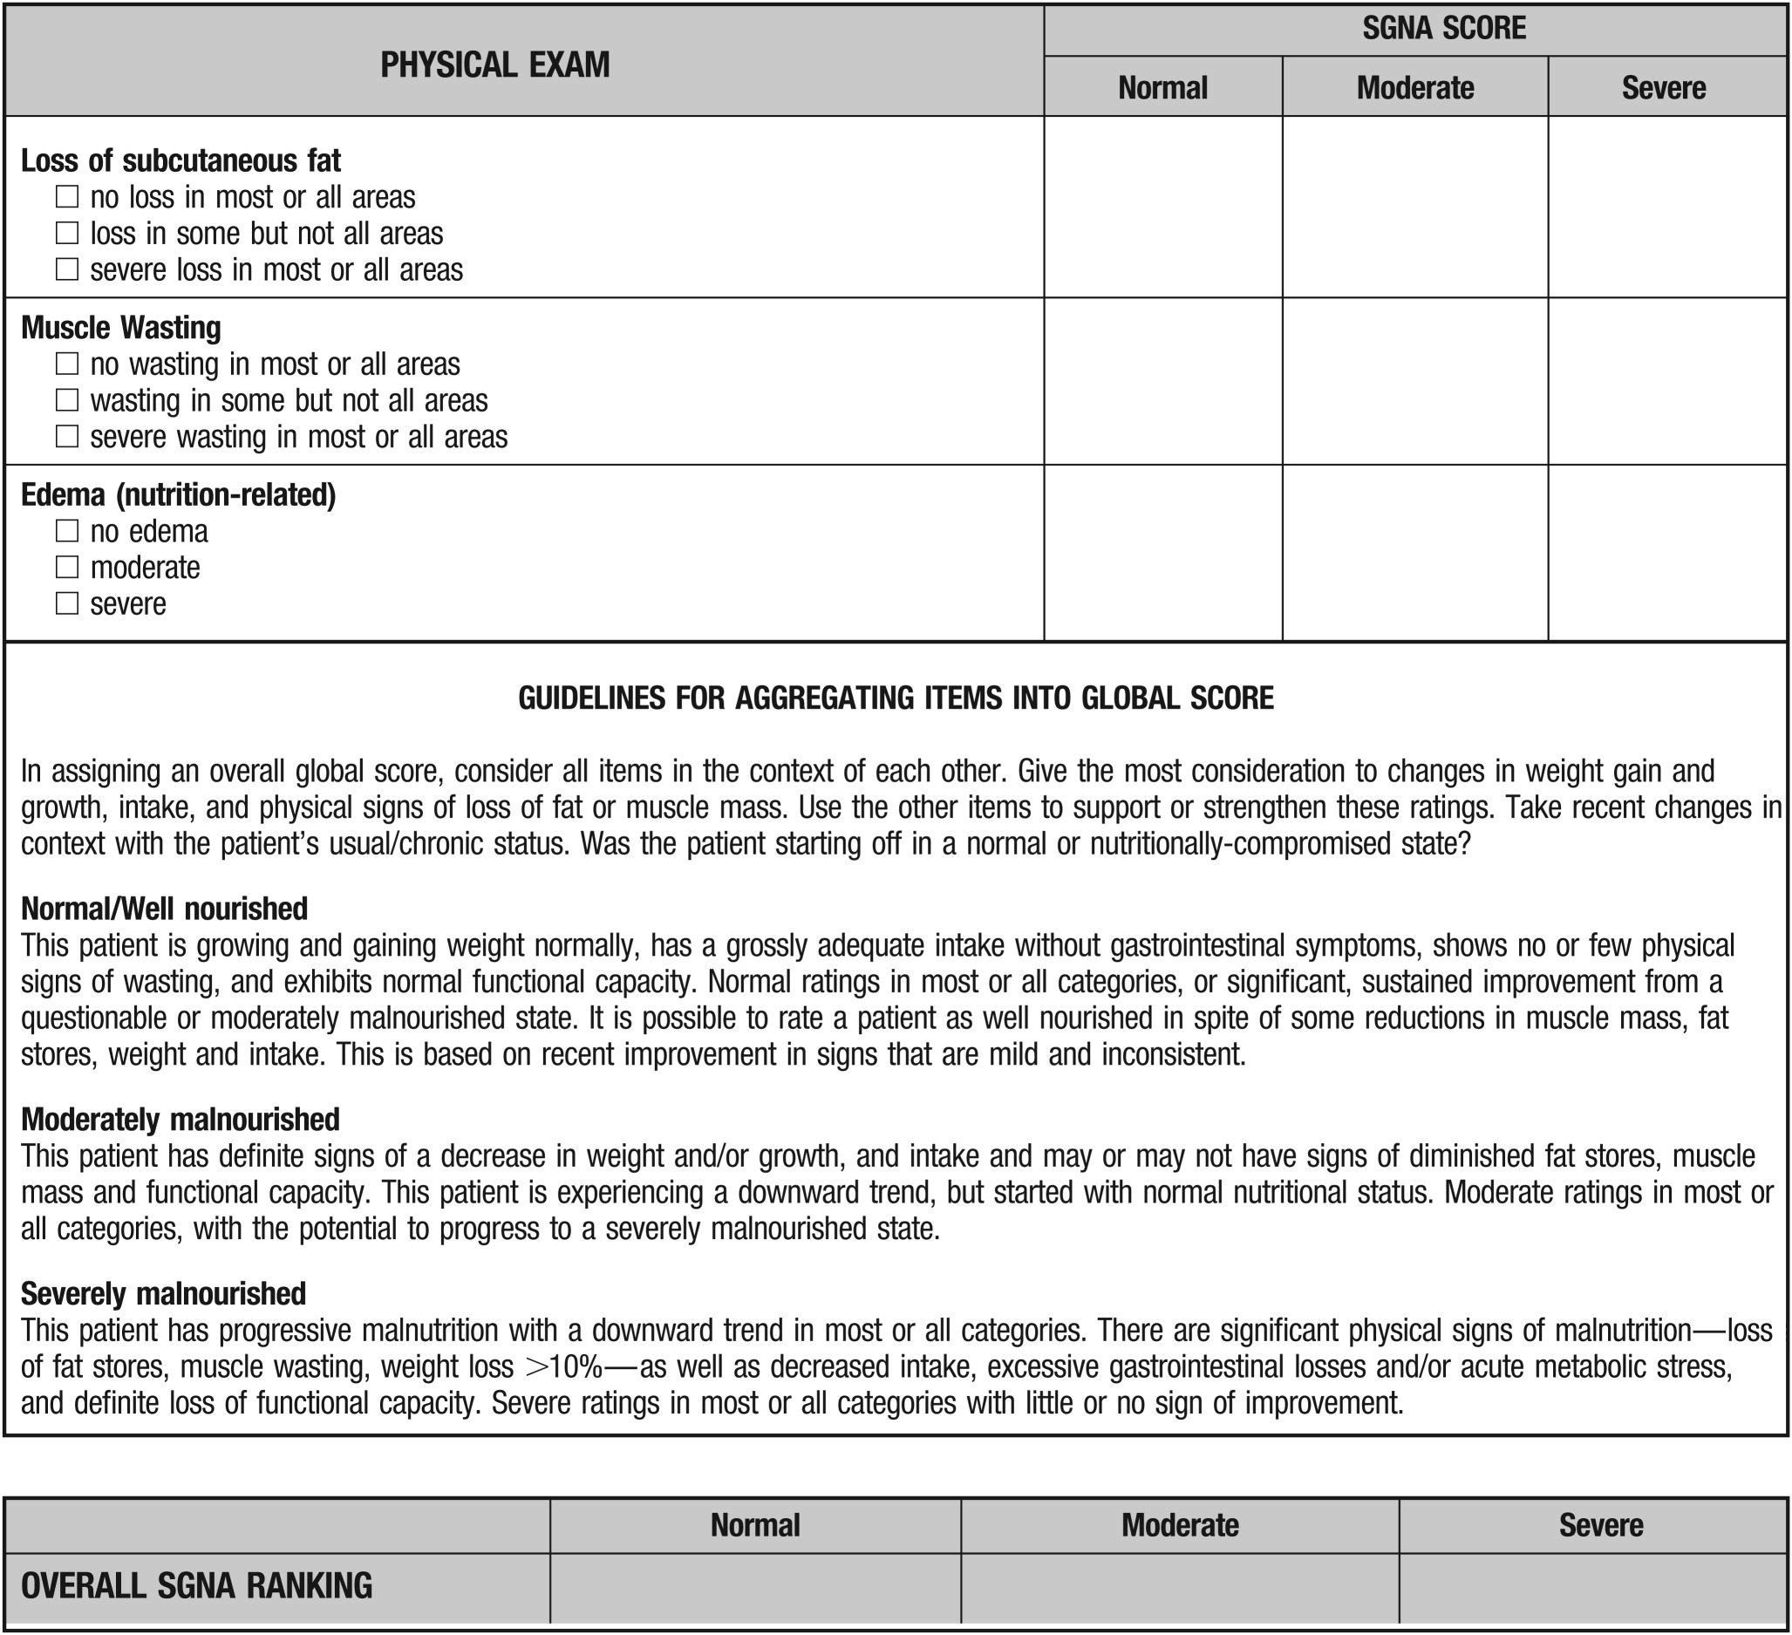
✓
✓
✓
✓
10th
✓
✓
✓
✓
✓
✓
✓
✓
13.8
✓
✓
97.9
✓
✓
✓
✓
✓
✓
✓
✓
✓
✓
✓
✓
✓
✓
✓
✓
✓
How would you define 4 year old female patient Sarah H.?
Well nourished
Moderately malnourished
Severely malnourished
✓
✓
✓
✓

Slide 19
✓
✓
✓
✓
10th
✓
✓
✓
✓
✓
✓
✓
✓
13.8
✓
✓
97.9
✓
✓
✓
✓
✓
✓
✓
✓
✓
✓
✓
✓
✓
✓
✓
✓
✓
How would you define 4 year old female patient Sarah H.?
Well nourished
Moderately malnourished
Severely malnourished
✓
✓
✓
✓

Slide 20
✓
✓
✓
✓
10th
✓
✓
✓
✓
✓
✓
✓
✓
13.8
✓
✓
97.9
✓
✓
✓
✓
✓
✓
✓
✓
✓
✓
✓
✓
✓
✓
✓
✓
✓
✓
How would you define 4 year old female patient Sarah H.?
Well nourished
Moderately malnourished
Severely malnourished
✓
✓
✓
✓

Slide 21
Thanks
Presented by Bailey Morrison
for 203 Assessment Course
Instructed by Dr. Nancy Hamler
University of the Pacific
Master of Clinical Nutrition program
Sacramento, California, USA
October 19, 2022

Slide 22
Resources
Detsky AS, McLaughlin JR, Baker JP, Johnston N, Whittaker S, Mendelson RA, Jeejeebhoy KN: What is subjective global assessment? J Parent Nutr Jan-Feb;11(1):8-13, 1987.
Donna J. Secker, Khursheed N. Jeejeebhoy, How to Perform Subjective Global Nutritional Assessment in Children, Journal of the Academy of Nutrition and Dietetics, Volume 112, Issue 3,2012, Pages 424-431.e6, ISSN 2212-2672, https://0-doi.org.pacificatclassic.pacific.edu/10.1016/j.jada.2011.08.039.
(https://0-www.sciencedirect.com.pacificatclassic.pacific.edu/science/article/pii/S0002822311015057)
Growth Chart training. Centers for Disease Control and Prevention. https://www.cdc.gov/nccdphp/dnpao/growthcharts/index.htm. Published April 15, 2015. Accessed October 18, 2022.
Nutrition Guidance for Healthy Children: CHILDHOOD NUTRITION AND GROWTH (2013). EAL. https://www.andeal.org/topic.cfm?cat=4894&conclusion_statement_id=251766&highlight=growth+charts&home=1. Accessed October 16, 2022.
World Health Organization. Pocket book of hospital care for children: guidelines for the management of common childhood illnesses. World Health Organization, 2013.
World Health Organization. WHO child growth standards: length/height-for-age, weight-for-age, weight-for-length, weight-for-height and body mass index-for-age: methods and development. World Health Organization, 2006.

Slide 23
Resources
PHOTOS in order of appearance:
Adorable baby waiting to be checked by doctor
Baby on length measuring mat
Doctor measuring newborn baby head
Infant length measurement technique diagram
Medical team in a doctor's office
Lateral view doctor talking to mother of a baby
Medium shot doctor talking to patient
Medium shot girl being checked
Osteopathist treating a kid by massaging him at the hospital
Medium shot doctor checking girl
Close-up of female's doctor hand checking the girl patient's throat and neck

